Slide 1
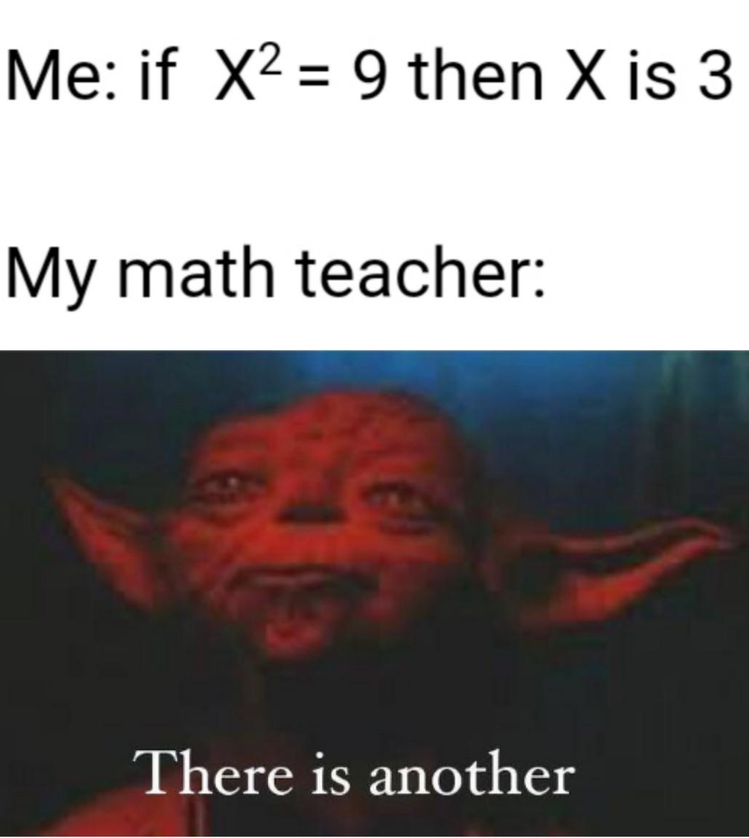
Welcome To College Algebra (w/Co-req)
Log into our Canvas Course to review syllabus.
Note any questions you have on course, syllabus, schedule, etc.

Slide 2
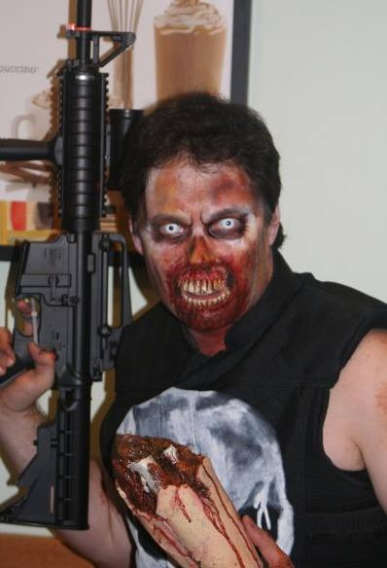
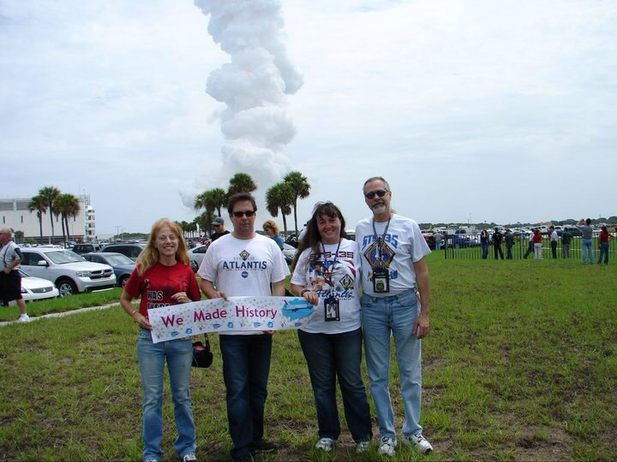
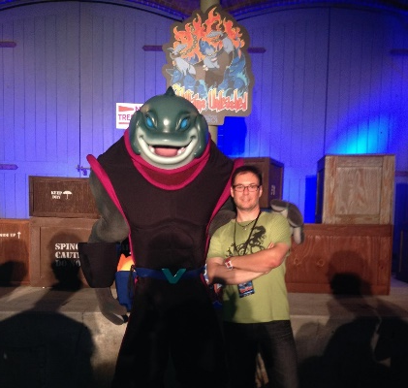
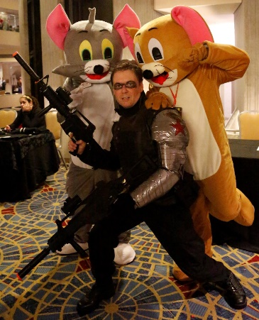

Slide 3
College Algebra w/Co-Req
This class will be different in many ways from other math classes you may have been in. You will have a lab before each class where you are going to interact with each other.
I know that some of you do not like to talk in class and that others of you like to talk a lot. So, we will be following a couple of easy rules. We give everyone a chance to talk. We respond to whatever anyone says with respect. We are concerned here about concepts that will help you learn, and I expect that students in this class will support each other in working together.
I (You) will put you (yourselves) into groups, and I will expect that you will contribute to the discussion of the problems that your group is working on.

Slide 4
Syllabus & Schedule Activity
Fill out Team Worksheet
(I will be collecting this worksheet.)
The task of each group is to produce something that is common to your team, something that is “not obvious”. (This will help to form social ties to your peers.) You will be reporting out your commonality. As a Group, help each other answer any questions that you have about class (syllabus, schedule, etc.).
Come up with at least two questions (or comments) from the syllabus.
Any other questions?
Fill out Team Worksheet

Slide 5
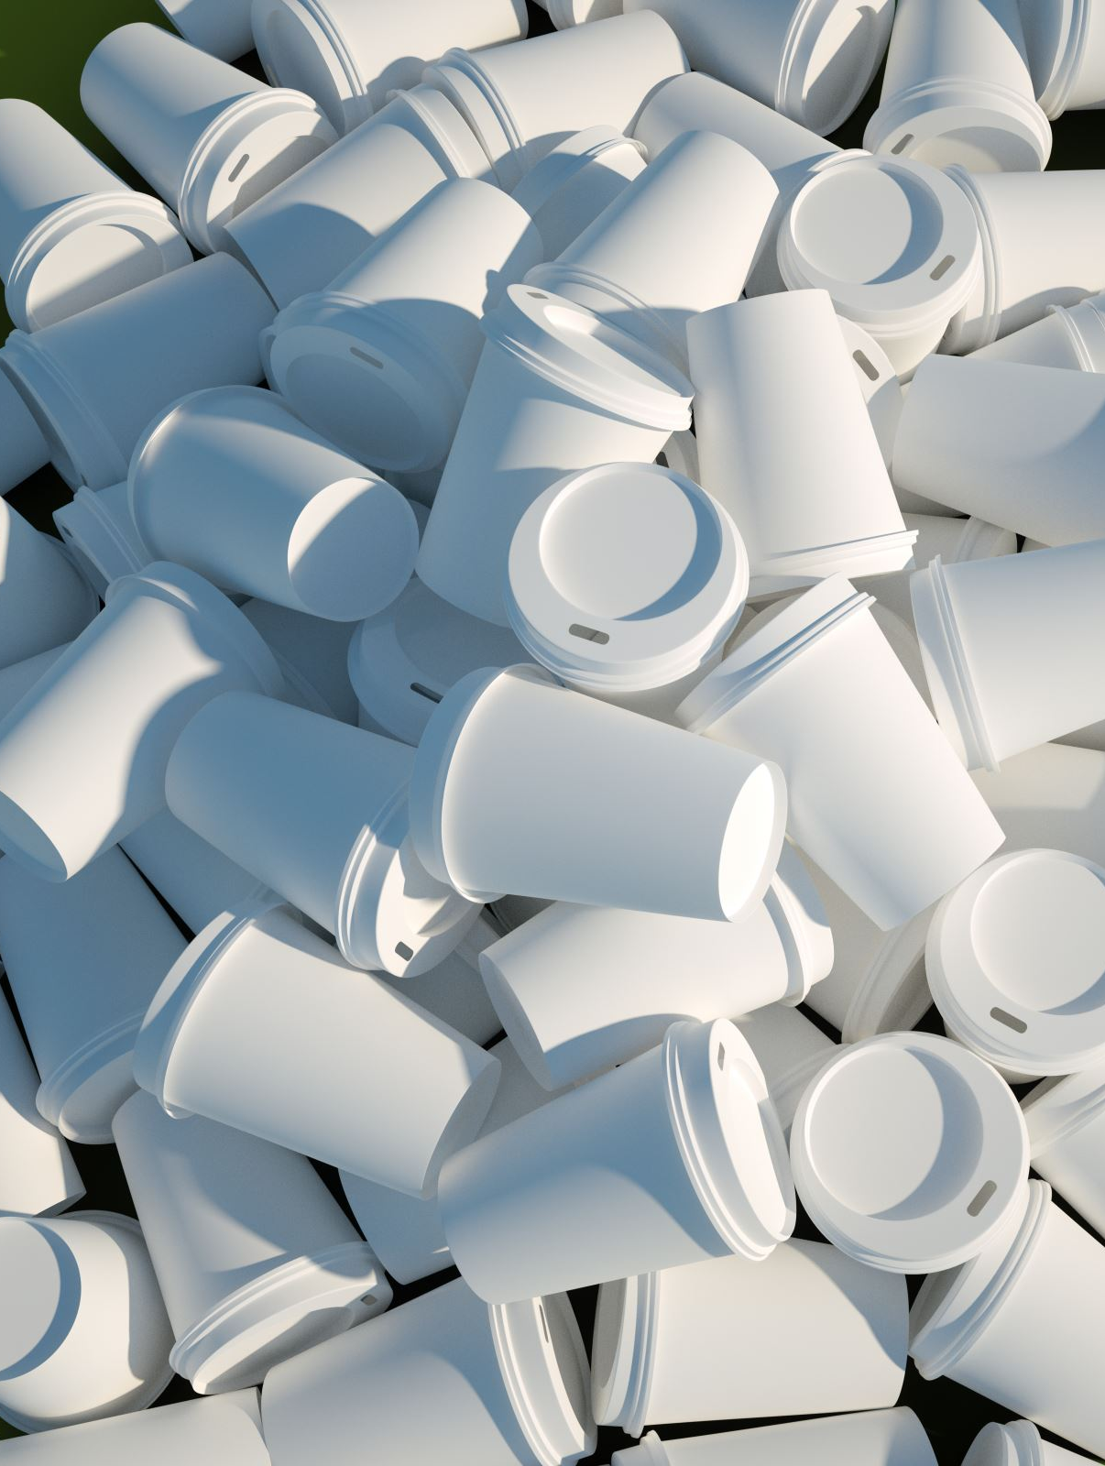
Construction Challenge
How fast can your team build a pyramid out of cups without touching the cups directly with your hands?

Slide 6
Construction Challenge
Create a tool using your kit (string/rubber band).
Rules: (when you start to build)
Each string can only be held at the very end.
You may NOT touch your partners string at anytime!
You may NOT touch your rubber band at anytime!
Your hands may NOT touch the cups anytime they are on the table
Start with 8 cups up, 8 cups down.
Pyramid layout picture in kit
If you drop your cup on the floor, you may pick it up and place it on the corner of your table to continue.
Break ANY RULE: You will have to restart!
Any Questions?

Slide 7
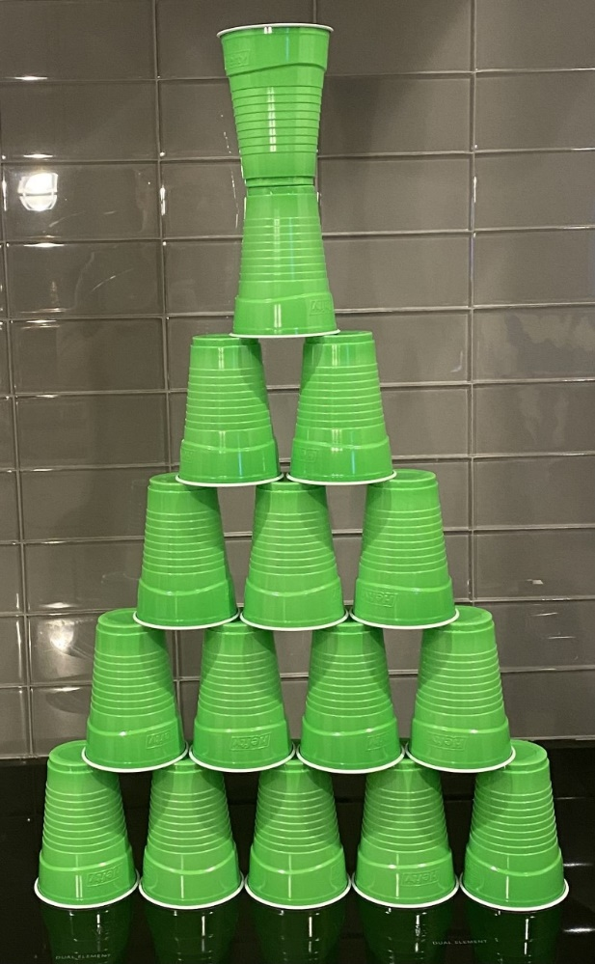
Wrap Up
What were some of the challenges your group faced during construction? How did you resolve the conflicts that came up?
What creativity and collaboration techniques did your group undertake to complete this activity successfully?
How did you support your team members through this activity?

